Slide 1

Super Mega Battle Royale
Matthew Young, Faizan Ahmad, and Kendra Ninglekhu

Slide 2

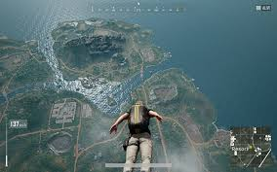
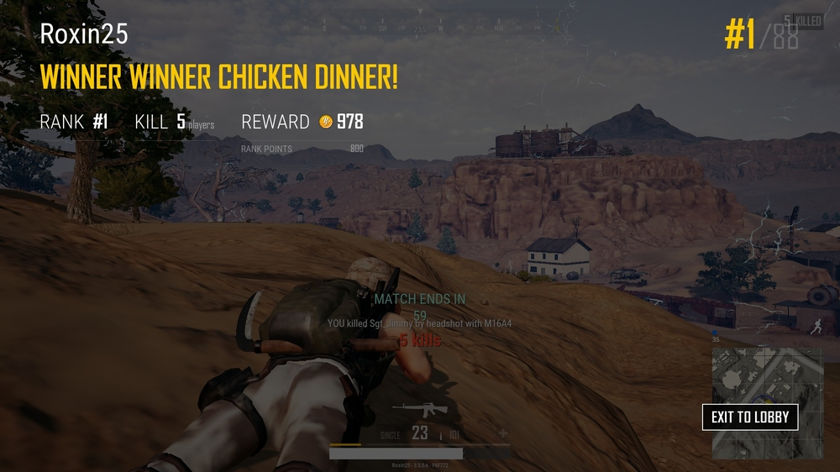
Game Summary
You and 99 other players are dropped into a slowly constricting safe zone that is surrounded by radiation. Using weapons, vehicles, and armor your goal is to be the last one alive.

Slide 3
Rules
If you run out of health, you die.
You need the correct ammo type for the weapon you want to use.
You can spectate your teammates or a random player after death.
You can revive and be revived by allies before their revive timer runs out.
Radiation will slowly kill you.
Physics exist in game and will realistically effect your character.
Friendly fire is active.

Slide 4



Competitors:
Battlefield V
Fortnite
Apex: Legends

